Slide 1
Csc 128 Fundamentals To Computer Solving
Mohd Yazid Mohd Anas Khan
WhatsApp: 019 - 8285105
FKE UiTM Sarawak KS1

Slide 2
Chapter 1 : INTRODUCTION
WHAT IS A COMPUTER PROGRAM?
Program
A set of instructions that directs the computer to perform specific tasks
Another term : software (program installed in a computer)
Programming language
program written in programming languages that contain the set of instructions, data and rules
Examples of programming languages are C/C++, COBOL, Visual Basic, Python, JavaScript.
Programming, Programmers, Users
process of writing or coding programs is called programming
individuals who write programs are called programmers
Users on the other hand are individuals who use the program

Slide 3
IMPORTANCE OF COMPUTER PROGRAMMING
A computer without a program is useless.
A computer must have a program to input, process and output data.
Windows asking user to enter password
User turning on the computer (input to the computer’s BIOS)
Before a program is written, a programmer analyses the requirements and designs a correct algorithm so that the program will produce the desired output.
very important that programmers have a good understanding of computers, problem solving approaches and compositions of the chosen programming languages.

Slide 4
THE IMPORTANCE OF GOOD PROGRAMS
In order for a program to be considered as a good program, it must have the following criteria:
Reliability of output
Must be able to produce correct output.
A different set of input data is used to ensure the reliability of the output.
Program’s efficiency
Efficient and reliable in the sense that it produces no errors during execution process. The program must achieve its purpose.
Interactivity
Interaction between user and program must be well defined. --so that the user knows the processing status.
User friendly allow the users to respond to instruction correctly and this will help the users to key in valid input not false input
Program Readability
Readability is concerned with how other person views one’s program.
For programmers, the use of indentation and comments are common to improve the programs readability.

Slide 5
THE IMPORTANCE OF GOOD PROGRAMS (cont)
Indentation (using Tab key)
making the structure of the program clearer and easier to read.
A statement within a statement should be indented to show the user which statements are subordinate of the other.
Comments
Comments (sometimes referred to as internal documentation) should be place in the program coding to improve its readability.
comments are there for the convenience of anyone reading the program.
Two types of comments:
Line comments – begins with two slashes (//) and continues to the end of line.
//declare variable
Block comment – begin with the symbols /* and end with symbols */. Block comments are conveniently used for statement that span across two or more lines.
/* This program to display name,
address, IC No,
And address. */

Slide 6
RELATIONSHIP BETWEEN COMPILERS, INTERPRETERS AND PROGRAMS
Before the emergence of high-level languages, programmers write programs using the machine and assembly languages.
Machine and high-level languages
Computers can only understand machine language that is in binary form of 1’s and 0’s.
However, programmers have hard times understanding the codes if they were to program in machine language.
Example:
1100
11001010 1000001 1000101 001011

Slide 7
RELATIONSHIP BETWEEN COMPILERS, INTERPRETERS AND PROGRAMS (cont)
To overcome this problem, other programming languages such as assembly language and high level languages developed. High level language resembles human languages in many ways.
Example of an assembly language:
Example of high level language (C++)
MOVE hours, a
MOVE rate, b
MUL grossWages,hours,rate
MUL tax,0.07,grossWages
grossWages = hours * rate;
tax= 0.07 * grossWages

Slide 8
RELATIONSHIP BETWEEN COMPILERS, INTERPRETERS AND PROGRAMS (cont)
Both languages ease the process of writing programs.
However computers still cannot understand these languages i.e assembly and C++
As a result these programs must be translated into machine language (1s and 0s).
Thus programs written in other language such as C++ need to go through a process called COMPILING.

Slide 9
Compiling a C++ program
Compiling = process to convert the program instructions into equivalent machine language.
During compilation of program, a compiler will convert the entire program into machine language.
Interpreter is also used to convert a program into machine language. But it will translate one program statement a time a time, instead of the entire program. E.g Python language

Slide 10
Source code
The original program written in assembly or high level languages.
The file containing the source code is called the source file, and in C++ it uses the filename extension .cpp (C plus plus)

Slide 11
Object code
Created from the compilation process in machine readable form.
The file containing the object code is called the object file and it uses the file extension .obj (object)
After the compiler creates the object file, it then invokes another program called a linker.
The linker combines the object file with other machine code necessary for C++ program to run correctly. It then produces an executable that has an extension of .exe (executable)

Slide 12
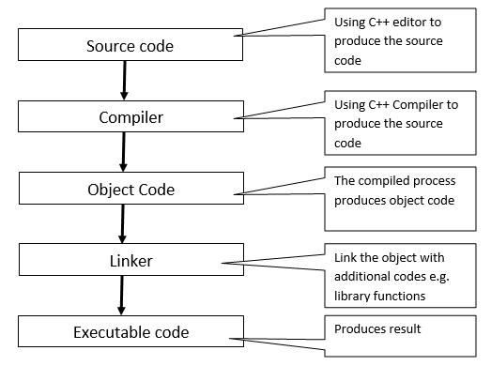
Translation Process for C++
Done by you
Done by computer

Slide 13
Chapter1 : PROGRAM DEVELOPMENT LIFE CYCLE
there is no complete set of rules or specific algorithm to follow in designing program
software developers try to use a reasonably consistent problem solving approach for constructing computer programs

Slide 14
Phases in the problem solving approach
Problem Definition (Analysis)
Algorithm Design
Algorithm Implementation
Program testing
Program Maintenance

Slide 15
Problem Definition (Analysis)
The problem is defines to obtain a clear understanding of the problem requirement.
The following questions should be asked to get a complete problem specification:
What are the input data?
What are the output (desired data)?
What formula is to be used?
What other assumptions or constraints can be made?
What is the expected output screen?

Slide 16
Algorithm Design
The specifications derived earlier in analysis phase are translated into algorithm.
An algorithm is a step-by-step sequence of precise instructions that must terminate and describes how the data is to be processed to produce the desired outputs.
An algorithm must satisfy some requirements:
Input and output – it must have input and must produce at least one output
Unambiguous – every step is an algorithm must be clear as to what it is supposed to do and how many times it is expected to be executed.
Correct and efficient - It must be correct and efficiently solve the problem for which it is designed
Finite – it must execute its instruction and terminate in a finite time.

Slide 17
Algorithm Design using Pseudocode
Guides to create pseudo code:
Each step in an algorithm have not more than 2 actions.
Steps are done sequentially in an algorithm.
Use “Start”, “End” to indicate the starting and ending point.
Create variable names.
Use arithmetic symbols for mathematical operations(+, -, /, *).
A ← B is used to represent the process of assigning B value to A.
Use relationship operators(<, <=, >, >=, !=, ==) to represent the relationship between 2 values.

Slide 18
Algorithm Design using Pseudocode
Example of pseudocode for the car starting process:
Start
Insert the key.
Transmission is in Park (or neutral).
Depress the gas pedal.
Turn the key to the start position.
If the engine starts within 6 second,
a) release the key to the ignition position.
7. else
a) repeat step 5 and 6, not more than 5 times.
b) If more than 5 times, call the garage.
8. End

Slide 19
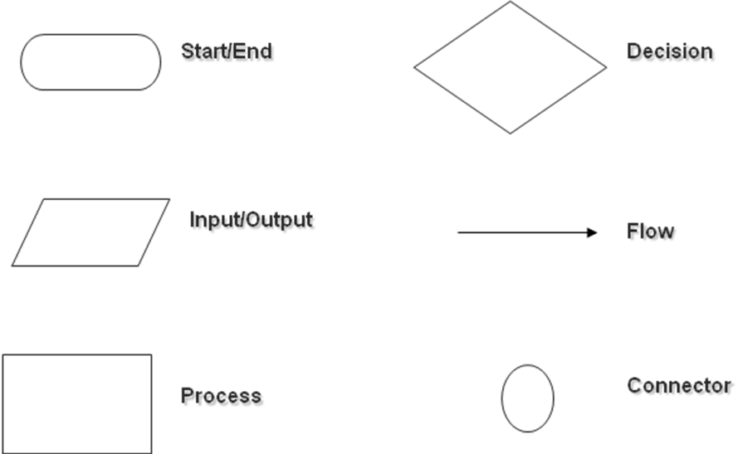
Algorithm Design using Flowchart
A graphical representation of geometrical symbols used to show the sequence of an algorithm.

Slide 20
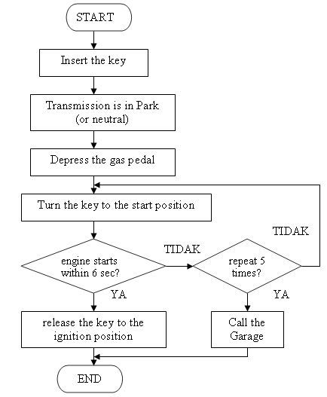
Example of Flowchart

Slide 21
Algorithm Design using Flowchart (cont)
Most computer algorithms consist of at least the following processes:
Get the data
Perform the computations
Display the results

Slide 22
Algorithm Implementation
It means now you start coding based on the algorithm using C++ or other programming languages
The process is called coding which involves editing, compiling and debugging

Slide 23
Program Testing
Requires testing the completed program to verify that it produces expected output.
A different set of testing data is normally used to verify that the program works properly and that it is indeed solving the given problem.

Slide 24
Program Maintenance
Often there may be new requirements to be added into the current program. Making revisions to meet the changing needs with ongoing correction of problems are the major efforts in the program maintenance. As a result the program codes may be modified, added or deleted accordingly.

Slide 25
EXAMPLE of Program Development :
Write a program to compute sum of two integer numbers.

Slide 26
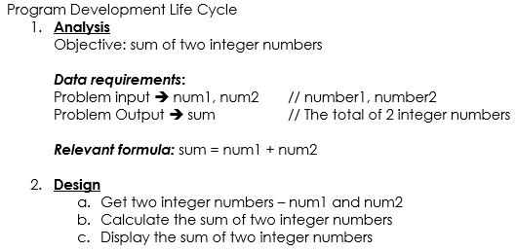
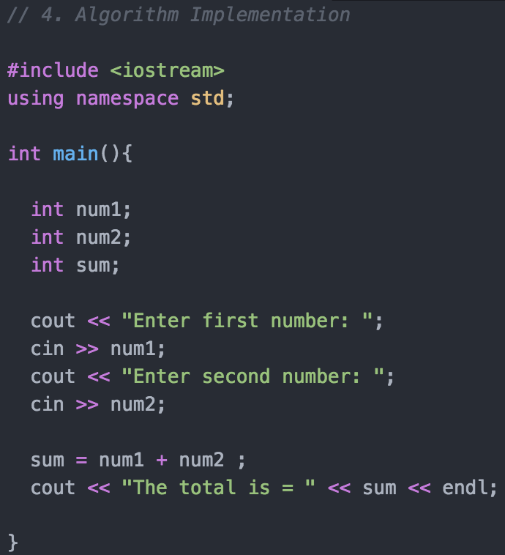
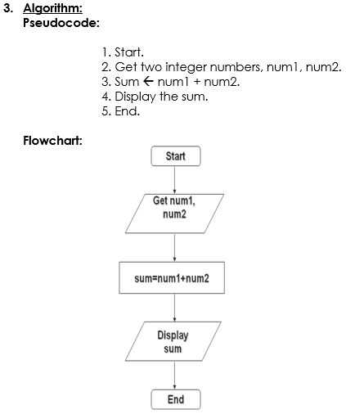
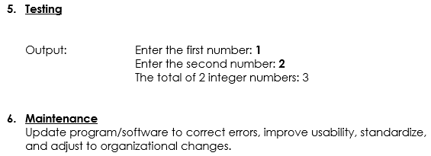

Slide 27
EXERCISES
. Find the difference of two integer numbers.
. Compute and output the average of two floating-point numbers entered from the keyboard.
. Write an algorithm for the metric conversion program to convert distance in kilometers to miles. (do in class)
(Hint: 1 kilometer = 0.6214 miles)
Answers: https://github.com/macunixs/csc128

